Slide 1
Introduction to Algorithms
Recurrence Relations
Lecture 4
Dr. Ramalingaswamy

Slide 2
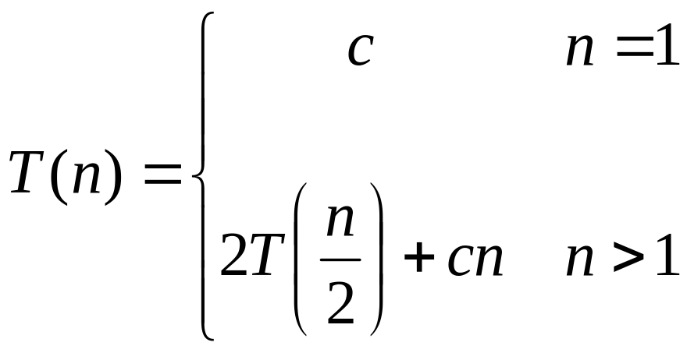
Recurrences
The expression:
is a recurrence.
  Recurrence: an equation that describes a function in terms of its value on smaller functions

Slide 3

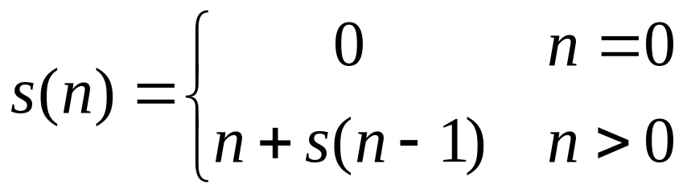

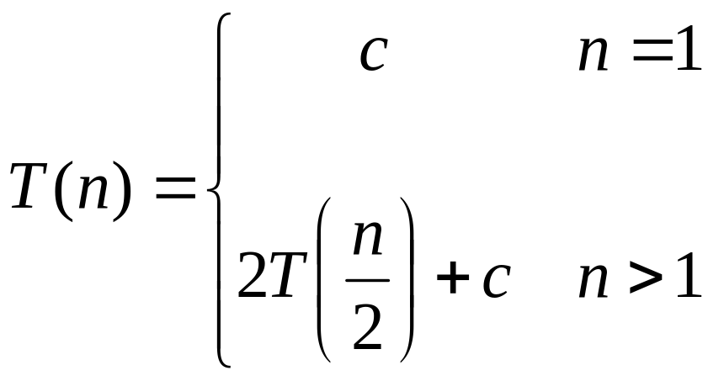
Recurrence Examples

Slide 4
Solving recurrences
  Iteration method
  Recursion Tree Method
  Master’s Method

Slide 5
Method 1: Iteration Method
In the iteration method we iteratively “unfold” the recurrence until we “see the pattern”.

Slide 6

Example:

Slide 7
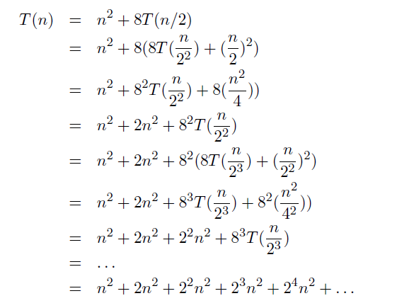
Solution:

Slide 8
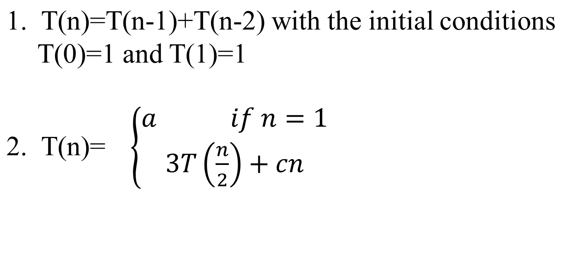
More Examples

Slide 9
Recursion-tree method

Slide 10
Solving Recurrences using Recursion Tree Method
Here while solving recurrences, we divide the problem into
subproblems of equal size.
For e.g., T(n) = a T(n/b) + f(n) where a > 1 ,b > 1 and f(n) is a given
function .
F(n) is the cost of splitting or combining the sub problems.
n
T n/b
T n/b
Recursion depth: How long (how many iterations) it takes until the sub problem has constant size?

Slide 11
Example of recursion tree
Solve T(n) = T(n/4) + T(n/2) + n²:

Slide 12
Example of recursion tree
Solve T(n) = T(n/4) + T(n/2) + n²:
T(n)

Slide 13
Example of recursion tree
Solve T(n) = T(n/4) + T(n/2) + n²:
n²
T(n/4)
T(n/2)

Slide 14
Example of recursion tree
Solve T(n) = T(n/4) + T(n/2) + n²:
n²
(n/4)²
(n/2)²
T(n/16)
T(n/8)
T(n/8)
T(n/4)

Slide 15
Example of recursion tree
Solve T(n) = T(n/4) + T(n/2) + n²:
n²
(n/4)²
(n/2)²
(n/16)²
(n/8)²
(n/8)²
(n/4)²
…
Θ(1)

Slide 16

Example of recursion tree
Solve T(n) = T(n/4) + T(n/2) + n²:
n²
(n/4)²
(n/2)²
(n/16)²
(n/8)²
(n/8)²
(n/4)²
…
Θ(1)

Slide 17
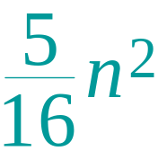
Example of recursion tree
Solve T(n) = T(n/4) + T(n/2) + n²:
n²
(n/4)²
(n/2)²
(n/16)²
(n/8)²
(n/8)²
(n/4)²
…
Θ(1)

Slide 18
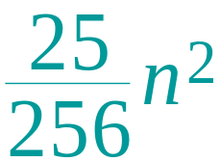
Example of recursion tree
Solve T(n) = T(n/4) + T(n/2) + n²:
n²
(n/4)²
(n/2)²
(n/16)²
(n/8)²
(n/8)²
(n/4)²
…
…
Θ(1)

Slide 19
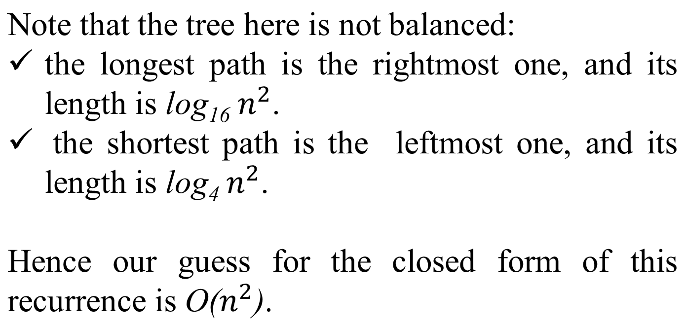
Cont…
…

Slide 20
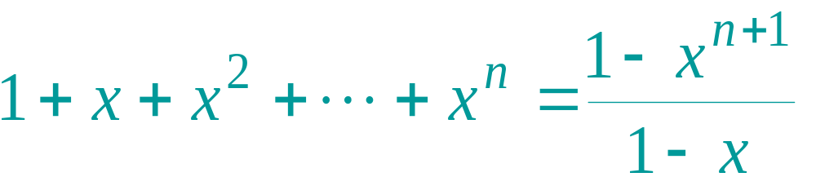
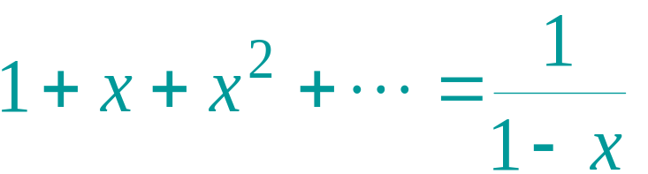
Appendix: geometric series
for x ≠ 1
for |x| < 1
Return to last slide viewed.

Slide 21
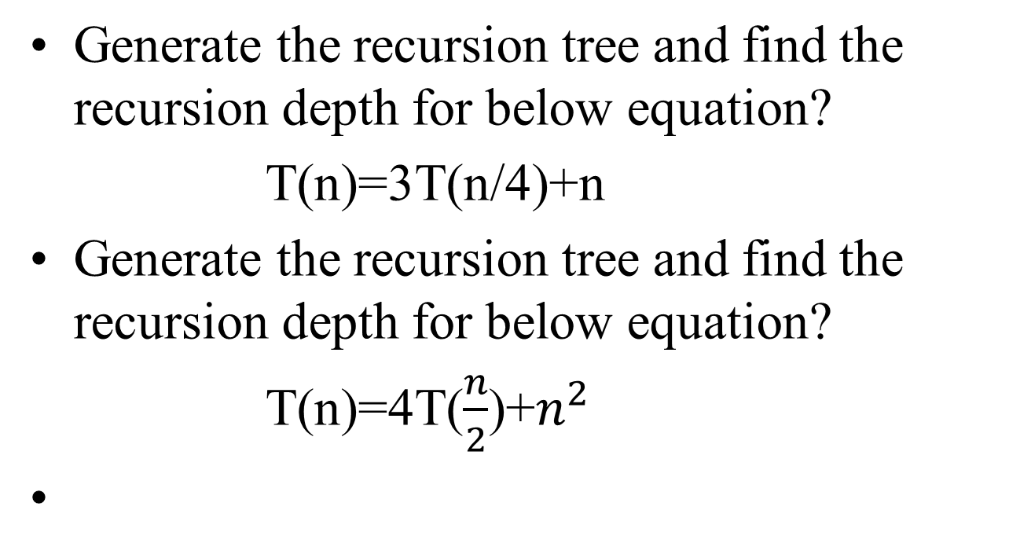
More Examples

Slide 22
Solving Recurrences using Recursion Tree Method
Here while solving recurrences, we divide the problem into
subproblems of equal size.
For e.g., T(n) = a T(n/b) + f(n) where a > 1 ,b > 1 and f(n) is a given
function .
F(n) is the cost of splitting or combining the sub problems.
n
T n/b
T n/b

Slide 23
1) T(n) = 2T(n/2) + n
The recursion tree for this recurrence is :
n
n/2 n/2 n
log₂ n
:
:
:
n
T n/2
T n/2
n/2²
n/2²
n/2²
n/2²
1
1
1
1
1
1
1

Slide 24
When we add the values across the levels of the recursion tree, we get a value of n for every level.
We have n + n + n + …… log n times
= n (1 + 1 + 1 + …… log n times)
= n (log₂ n)
= Ɵ (n log n)
T(n) = Ɵ (n log n)

Slide 25
II.
Given : T(n) = 2T(n/2) + 1
Solution : The recursion tree for the above recurrence is
1 1 2
log n 4
1
:
:
:

Slide 26
Now we add up the costs over all levels of the recursion tree, to determine the cost for the entire tree :
We get series like
1 + 2 + 2² + 2³ + …… log n times which is a G.P.
[ So, using the formula for sum of terms in a G.P. :
a + ar + ar² + ar³ + …… + ar ^{n – 1} = a( r ^{n} – 1 )
r – 1 ]
= 1 (2^{log} ^{n} – 1)
2 – 1
= n – 1
= Ɵ (n – 1) (neglecting the lower order terms)
= Ɵ (n)

Slide 27
III.
Given : T(n) = T(n/3) + T(2n/3) + n
Solution : The recursion tree for the above recurrence is
n
n/3 2n/3 n
log₃ n log_{3/2} n
n
1 n/3^{i}
:
:
:
n
n/3
2n/3
n
3²
2 n
3 3
1 2n
3 3
n .
(3/2)²

Slide 28
When we add the values across the levels of the recursion tree , we get a value of n for every level.
Since the shortest path from the root to the leaf is
n → n → n → n → …. 1
3 3² 3³
we have 1 when n = 1
3^{i}
=> n = 3^{i}
Taking log₃ on both the sides
=> log₃ n = i
Thus the height of the shorter tree is log₃ n
T(n) > n log₃ n … A

Slide 29
Similarly, the longest path from root to the leaf is
n → 2 n → 2 ² n → … 1
3 3
So rightmost will be the longest
when 2 ^{k} n = 1
3
or n = 1
(3/2)^{k}
=> k = log_{3/2} n
T(n) < n log_{3/2} n … B
Since base does not matter in asymptotic notation , we guess
from A and B
T(n) = Ɵ (n log₂ n)

Slide 30
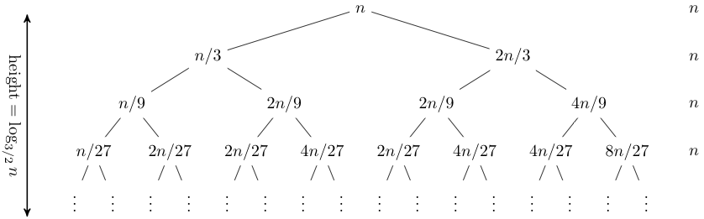
Note that the tree here is not balanced: the longest path is the rightmost one, and its length is log_{3/2} n. Hence our guess for the closed form of this recurrence is O(n log n).

Slide 31
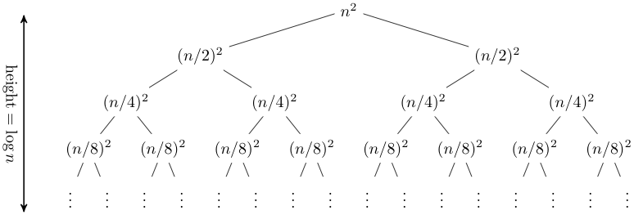
T(n) = 2T(n/2) + n²
The recursion tree for this recurrence has the following form
In this case, it is straightforward to sum across each row of the tree to obtain the total work done at a given level:

Slide 32
The master method
The master method applies to recurrences of the form
T(n) = a T(n/b) + f (n) ,
where a ≥ 1, b > 1, and f is asymptotically positive.

Slide 33
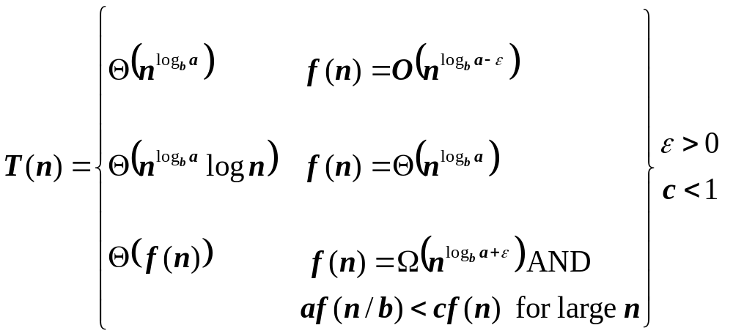
The Master Theorem
if T(n) = aT(n/b) + f(n) then

Slide 34
Three common cases
Compare f (n) with n^{logba}:
f (n) = O(n^{logba – ε}) for some constant ε > 0.
  f (n) grows polynomially slower than n^{logba} (by an n^{ε} factor).
Solution: T(n) = Θ(n^{logba}) .

Slide 35
Three common cases
Compare f (n) with n^{logba}:
f (n) = Θ(n^{logba} lg^{k}n) for some constant k ≥ 0.
  f (n) and n^{logba} grow at similar rates.
  Solution: T(n) = Θ(n^{logba} lg^{k+1}n) .

Slide 36
Three common cases (cont.)
Compare f (n) with n^{logba}:
f (n) = Ω(n^{logba + ε}) for some constant ε > 0.
  f (n) grows polynomially faster than n^{logba} (by an n^{ε} factor),
and f (n) satisfies the regularity condition that a f (n/b) ≤ c f (n) for some constant c < 1.
Solution: T(n) = Θ( f (n) ) .

Slide 37
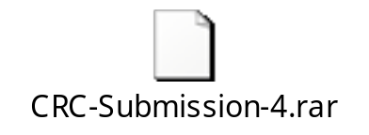
Examples
Ex. T(n) = 4T(n/2) + n
a = 4, b = 2 ⇒ n^{logba} = n²; f (n) = n.
CASE 1: f (n) = O(n^{2 – ε}) for ε = 1.
∴ T(n) = Θ(n²).
Ex. T(n) = 4T(n/2) + n²
a = 4, b = 2 ⇒ n^{logba} = n²; f (n) = n².
CASE 2: f (n) = Θ(n²lg⁰n), that is, k = 0.
∴ T(n) = Θ(n²lg n).

Slide 38
Examples
Ex. T(n) = 2T(n/4) + cn
CASE 2
Ex. T(n) = 16T(n/4) + n³
CASE 3
Ex. T(n) = 5T(n/2) + n²
CASE 2

Slide 39
Examples
Ex. T(n) = 4T(n/2) + n³
a = 4, b = 2 ⇒ n^{logba} = n²; f (n) = n³.
CASE 3: f (n) = Ω(n^{2 + ε}) for ε = 1
and 4(cn/2)³ ≤ cn³ (reg. cond.) for c = 1/2.
∴ T(n) = Θ(n³).

Slide 40
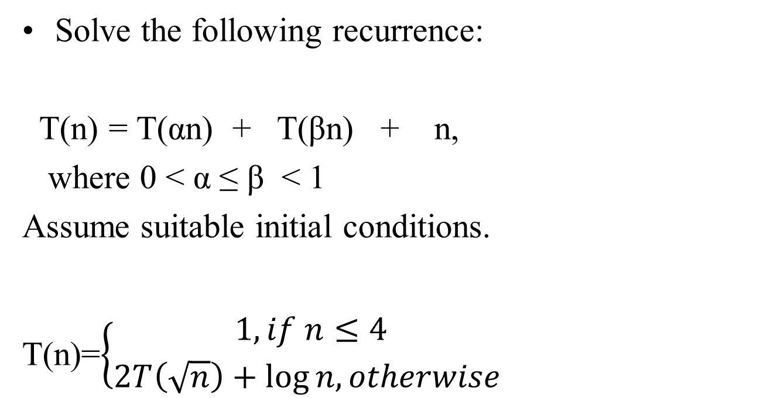
Assignment

Slide 41
Space Complexxity

Slide 42
Performance Analysis
There are two major criteria for judging algorithms that have a more direct relationship to performance.
storage requirement
computing time

Slide 43
Space Complexity
The space needed by a program has the following components.
  Instruction space
    Instruction space is the space needed to store the compiled version of the program instructions.
    The amount of instruction space that is needed depends on the compiler used to compile the program into machine code.

Slide 44
  Data space
    Data space is the space needed to store all constant and variable values. Data space has two components.
      Space needed by constants( ex; 1 and 2 in max of n num algorithm) and simple variables( such as i, j, n etc).
      Space needed by a dynamically allocated objects such as arrays and class instances.
    Space taken by the variables and constants varies from language to language and platform to platform.

Slide 45
  Environmental stack space
    The environment stack is used to save information needed to resume execution of partially completed functions.
    Each time a function is invoked the following data are saved on the environment stack.
      The return address .
      The values of all local variables and formal parameters in the function being invoked( necessary for recursive functions only).

Slide 46
  Therefore, We can divide the total space needed by a
  program into two parts:
i) Fixed Space Requirements (C)
Independent of the characteristics of the problem instance ( I )
    instruction space
    space for simple variables and constants.
  ii) Variable Space Requirements (S_{P}(I))
  depend on the characteristics of the problem instance ( I )
    Number of inputs and outputs associated with I
    recursive stack space ( formal parameters, local variables, return address ).
  Therefore, the space requirement of any problem P can be written as
  S(p)=C +S_{p}( Instance characteristics )

Slide 47
Note:
  When analyzing the space complexity of an algorithm, we concentrate only on estimating
  S_{p} (Instance characteristics ).
  We do not concentrate on estimating fixed part c .
  We need to identify the instance characteristics of the problem to measure S_{p}

Slide 48
Example1
Algorithm abc(a,b,c)
{
return a+b+b*c+(a+b-c)/(a+b)+4.0;
}
Problem instance characterized by the specific values of a,b,and c.
If we assume one word (4 bytes) is adequate to store the values of each a, b, and c , then the space needed by abc is independent of the instance characteristics.
Therefore, S_{abc}( instance characteristics)=0

Slide 49
Example2
Algorithm sum(a,n)
{
s:=0;
for i:=1 to n do
s:=s+a[i];
return s;
}
Problem instance characterized by n.
The amount of space needed does not depend on the value of n.
Therefore, S_{sum}(n)= n+3 (n for a[], one each for n, i, s

Slide 50
Example3
Algorithm RSum(a,n)
{
if(n ≤ 0) then return 0;
else return RSum(a,n-1)+a[n];
}
Type | Name | Number of bytes
formal parameter: int | a | 2
formal parameter: int | n | 2
return address ( used internally) |  | 2
Total per one recursive call |  | 6
Total no.of recursive calls n, therefore S_{RSum} (n)=6(n+1)

Slide 51
Method Stack in the JVM
1 main() {
int i = 5;
3 foo(i);
}
foo(int j) {
int k;
k = j+1;
7 bar(k);
….
}
9 bar(int m) {
…
}
The Java Virtual Machine (JVM) keeps track of the chain of active methods with a stack
When a method is called, the JVM pushes on the stack a frame containing
  Local variables and return value
  Program counter, keeping track of the statement being executed
When a method ends, its frame is popped from the stack and control is passed to the method on top of the stack
bar
PC = 9
m = 6
foo
PC = 7
j = 5
k = 6
main
PC = 3
i = 5
Elementary Data Structures

Slide 52
Example4
Calculate space complexity s_{p}(n) for the following algorithm
Algorithm rfactorial(n)
{
fact=1;
if (n=0 or n=1) return fact;
else
fact=n*rfactorial(n-1);
return fact;
}

Slide 53
Summary of UNIT-1
Intro to Algorithms
Asymptotic Analysis
Asymptotic Notations
Performance Analysis of Algo’s
  Time Complexity of Iterative Algorithms
  Time complexity of recursive Algorithms using iteration, recursion-tree, masters method.
Space Complexity

